Slide 1
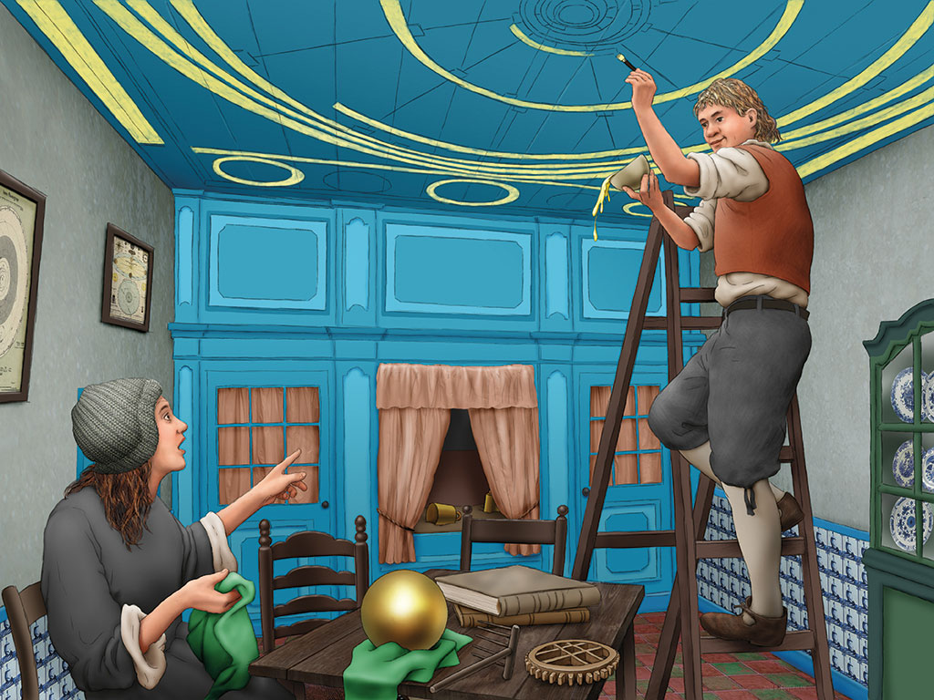
Scientific Revolution

Slide 2
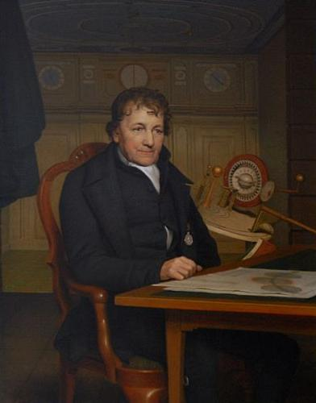
Eise Eisinga
Eise Eisinga
21 february 1744 - 27 august 1828 Franeker
Wool combing
Learned through self-study
At the age of 15 he wrote his first Math’s book
At the age of 17 he wrote his first book on astronomy
Build a planetarium that is still working
Introduction, magister
Eise Eisinga
Scientific Revolution
Recap
Ending

Slide 3
Scientific Revolution
Old Greek scientific thinking: Natural Philosophy or the study of nature
Ptolemaeus (Astronomy – earth in centre)
Galenus (Anatomy – Balance in body Liquids)
Middle Ages:
Fall of the West Roman Empire (500)
Scientific discoveries in Arabia (700 – 1500)
Renaissance:
No longer would the world be explained through the Bible, but through research as the ancient Greeks had done.
Fall of Constantinopel (1453)
Printing Press
Rationalism
Introduction, magister
Eise Eisinga
Scientific Revolution
Recap
Ending

Slide 4
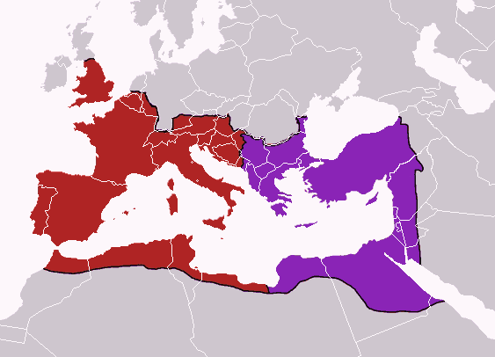
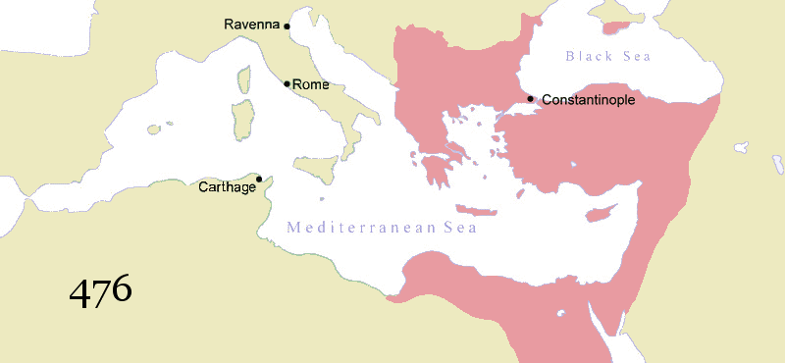
Recap

Slide 5
Scientific Revolution
Science in the Republic:
The Republic was popular because of the tolerance towards people who thought differently.
Therefor the Republic drew in alot of important “Enlightened” thinkers.
René Decartes (math, physics and philosopher)
Hugo de Groot (international law)
Christiaan Huygens (math, physics, astronomy)
Galileo Galilei (telescope)
Antoni van Leeuwenhoek (microscope – discovered micro-organisms)
Jan Swammerdam (improved microscope and discovered red blood cells)
Simon Steven (decimal system)
Jan Adriaanszoon Leeghwater (inpoldering)
Introduction, magister
Eise Eisinga
Scientific Revolution
Recap
Ending

Slide 6
Scientific Revolution
Reaction of the Church and Governments
The idea of modern science was that God created earth and the natural laws but no longer intervened.
Governments and Church did not like the idea’s and banned books that were to critical.
A Public Opinion forms
The Englightment was very popular with the Bourgeoisie, they came together in coffee houses, saloons and living rooms to read and discuss. A public opinion was formed.
The opinion of King and Church was no longer decisive. People now thought on their own.
Introduction, magister
Eise Eisinga
Scientific Revolution
Recap
Ending

Slide 7
Short Recap (Notes)
Eise Eisinga:
Wool comber who created a planetarium
Scientific Revolution:
Back to the way the ancient Greeks studied, by research and observation;
God created the Earth and the Natural Laws but no longer interfered;
Bourgeoisie started discussing and forming their own opinion, Public Opinion was formed;
Why the Republic?
Because of the tolerance lots of exiled thinkers settled in the Republic and started publishing;
Introduction, magister
Eise Eisinga
Scientific Revolution
Recap
Ending

Slide 8
Ending
Recreate Eise’s planetarium on paper!
Mercury, Venus, Earth, Mars, Jupiter, Saturn and the sun
Find examples of his Planetarium on the internet and recreate it on paper
Or
Make your own Planetarium on paper
Introduction, magister
Eise Eisinga
Scientific Revolution
Recap
Ending

